Slide 1
MATH 226: Introductory Computational MatheMatics
PROJECT WORK
GROUP TWO

Slide 2
OUTLINE
Participants
Abstract
Objectives
Terms and Resources Used
Main Content
Reference

Slide 3
PARTICIPANTS
Ayanful Emmanuel Kwame 10658737
Boateng Desmond Kofi 10678183
Arthur Jesfred Jinsun 10660931
Ashiabor Essie Nukunu 10668850
Ofosu-Dorte Darkor 10668544
Ablorh Robert 10659335
Abini Edwin Edem 10662590
Adiyiah Nicholas 10662573
Kwablah Emmanuel 10666011
Joseph Nyadroh 10477865
Collins Kwame Frimpong Manful 10658478

Slide 4
ABSTRACT
Cocoa has had it prices fluctuating over the past 19 years compared to Gold which experiences a more steady and sustained increase in it prices for the past 19 years.
Different factors contribute to the changes in price over the period aside inflation in the economy.

Slide 5
OBJECTIVES
At the end of this presentation, we want our audience to understand the following;
The trend analysis of Gold and Cocoa prices weekly, monthly and quarterly.
The causes of the fluctuations in the prices of Gold and Cocoa.
The relationship between the fluctuations in Gold and Cocoa Prices.

Slide 6
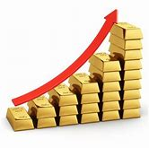
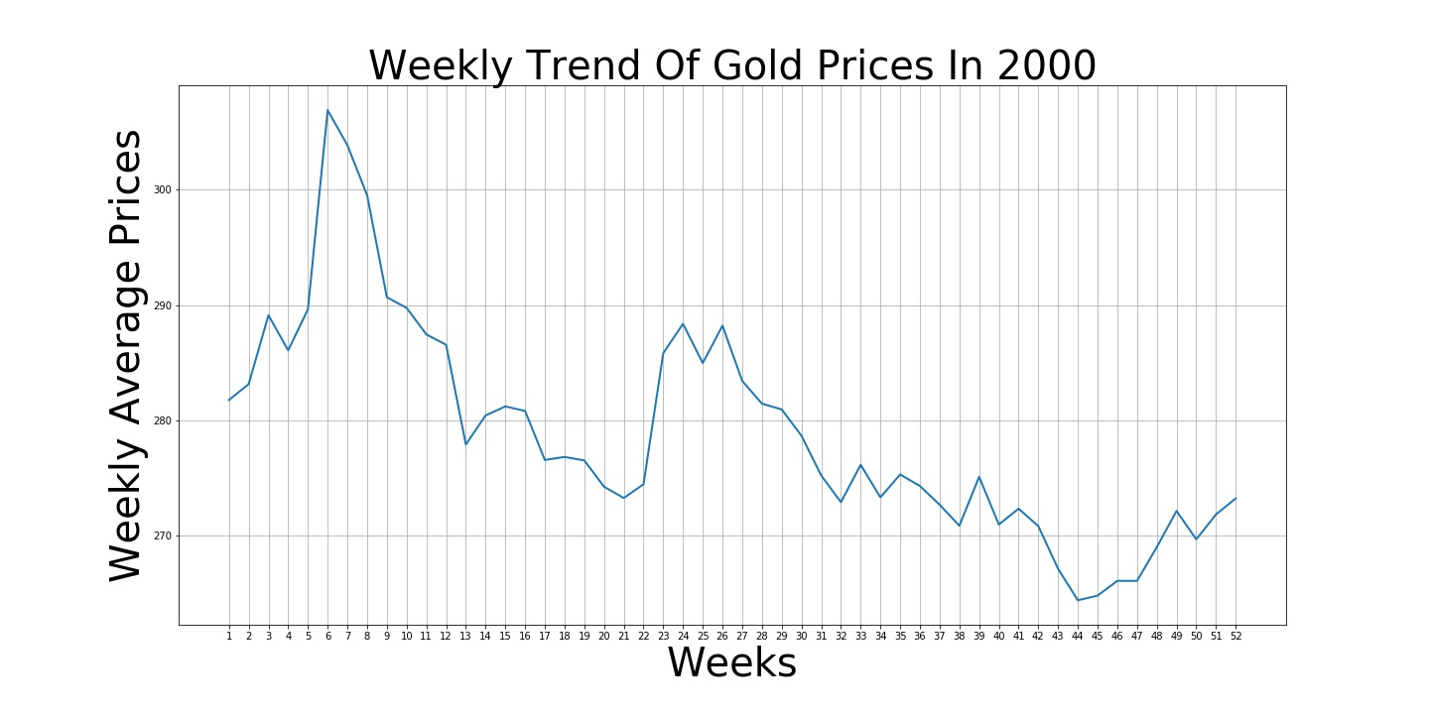

Slide 7
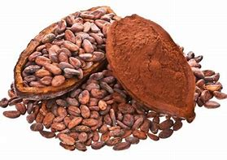
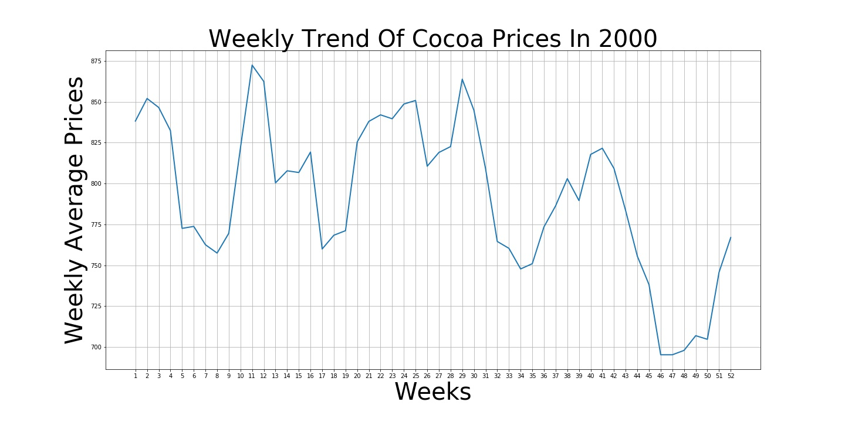

Slide 8
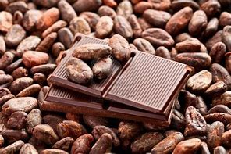
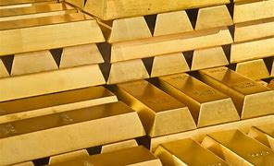
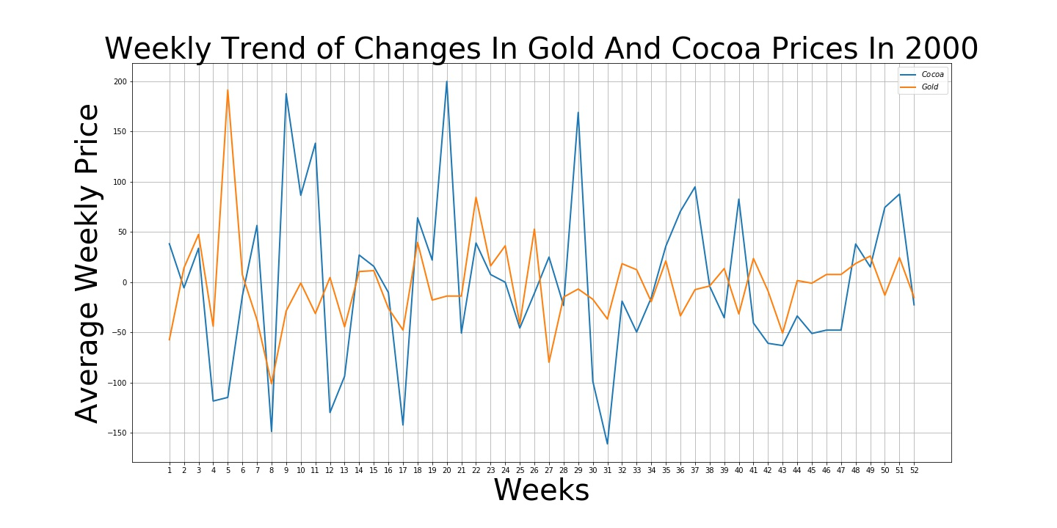

Slide 9
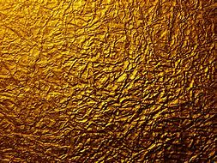
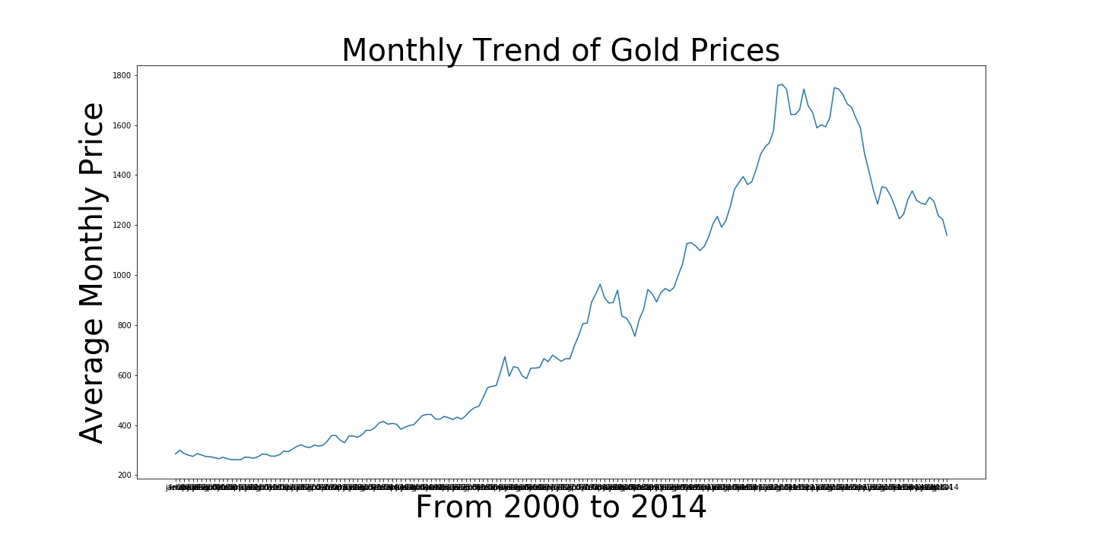

Slide 10
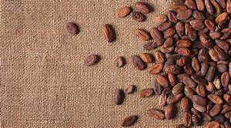
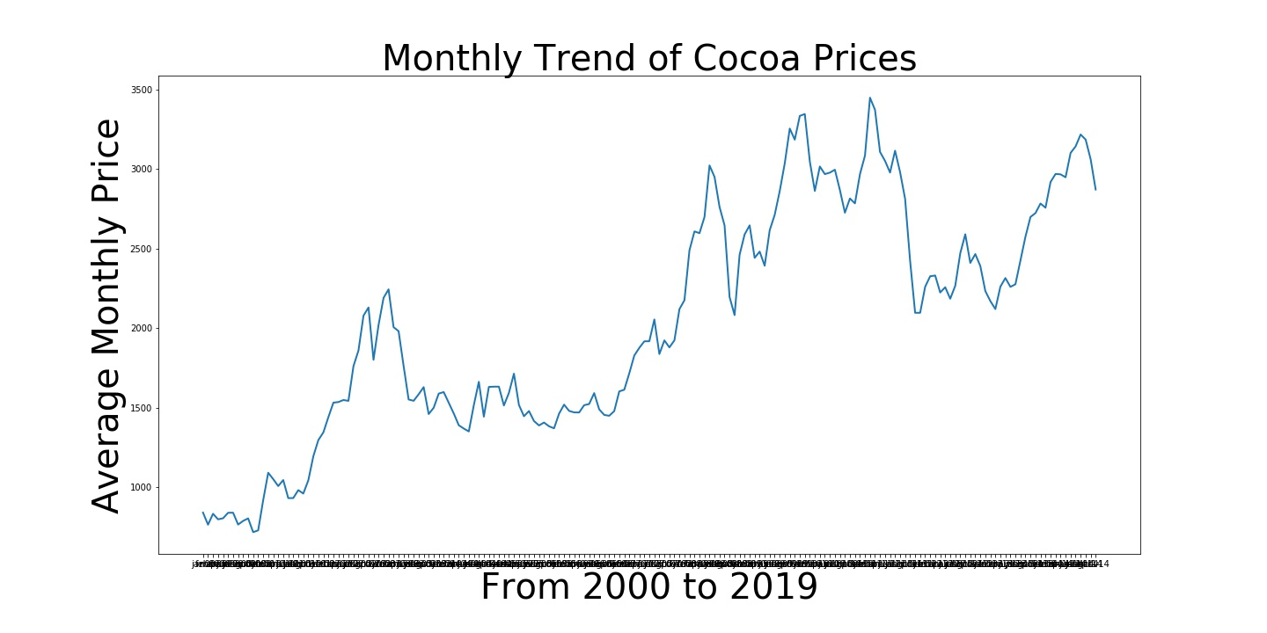

Slide 11
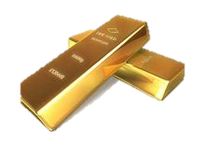
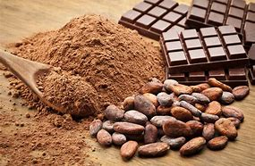
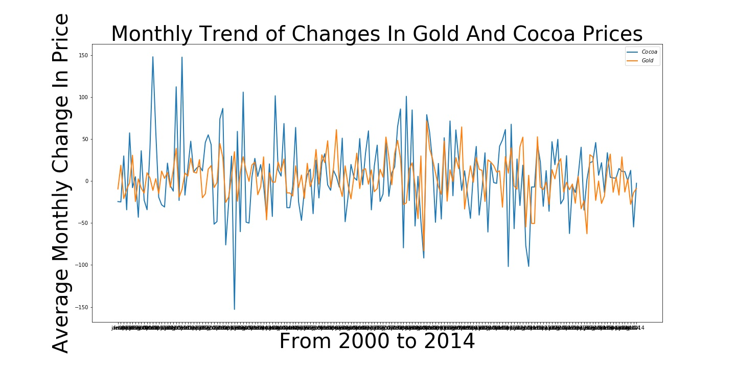

Slide 12
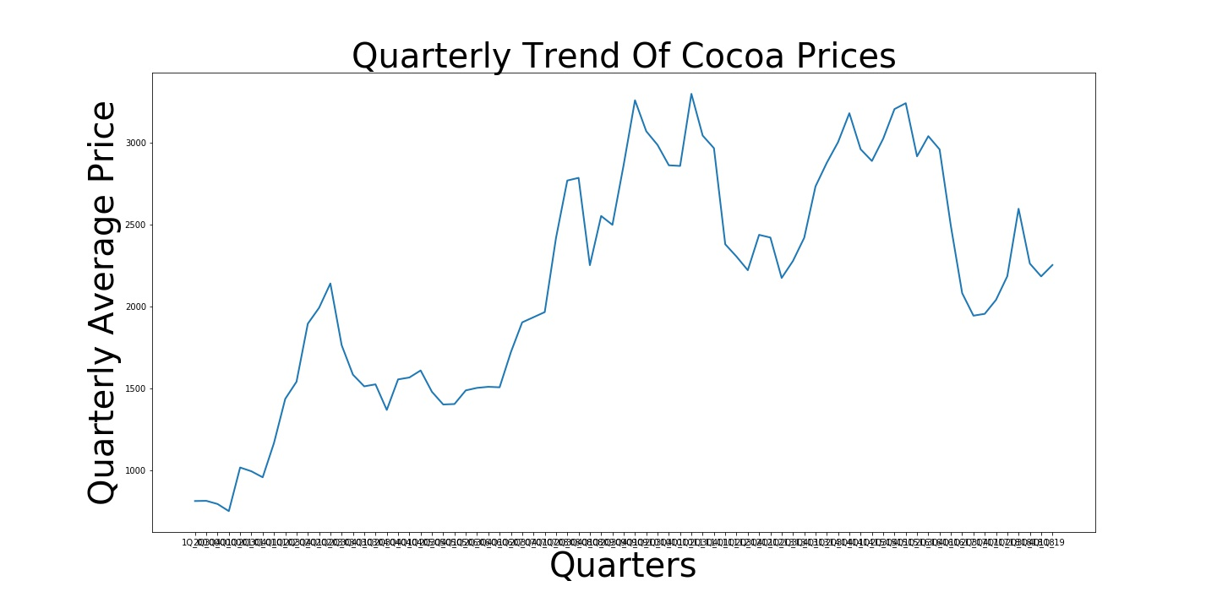

Slide 13
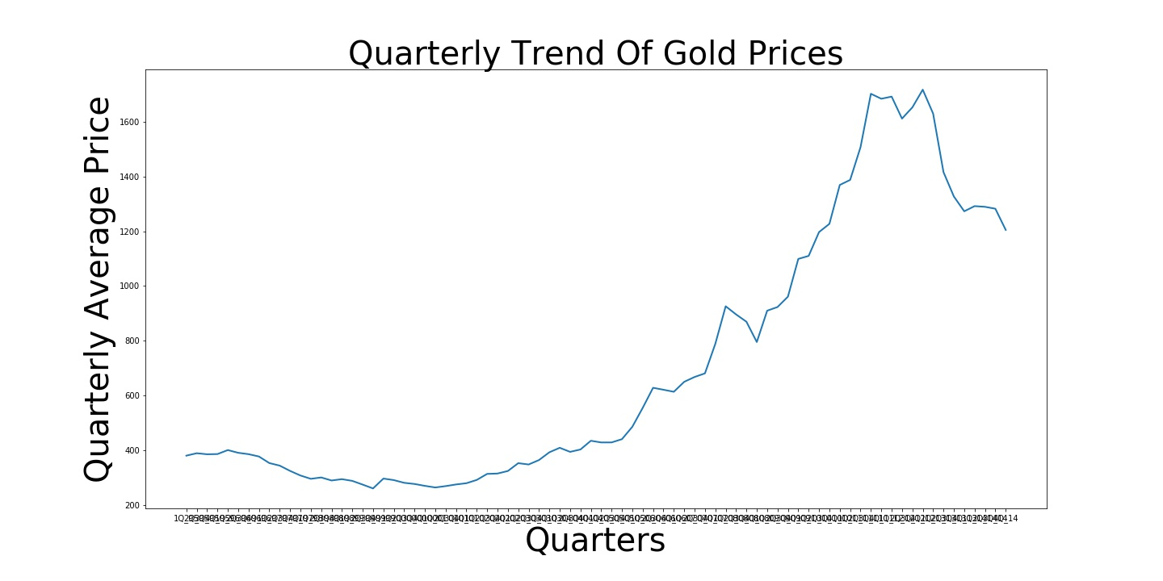

Slide 14
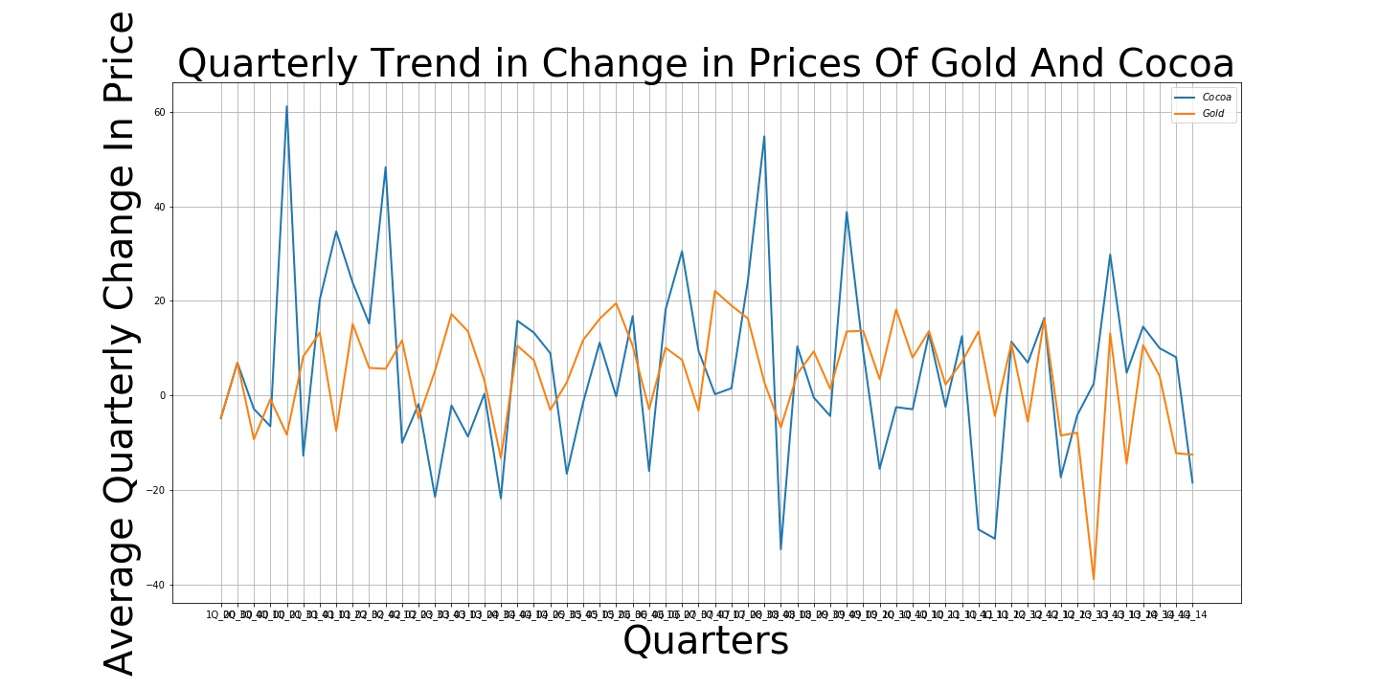

Slide 15
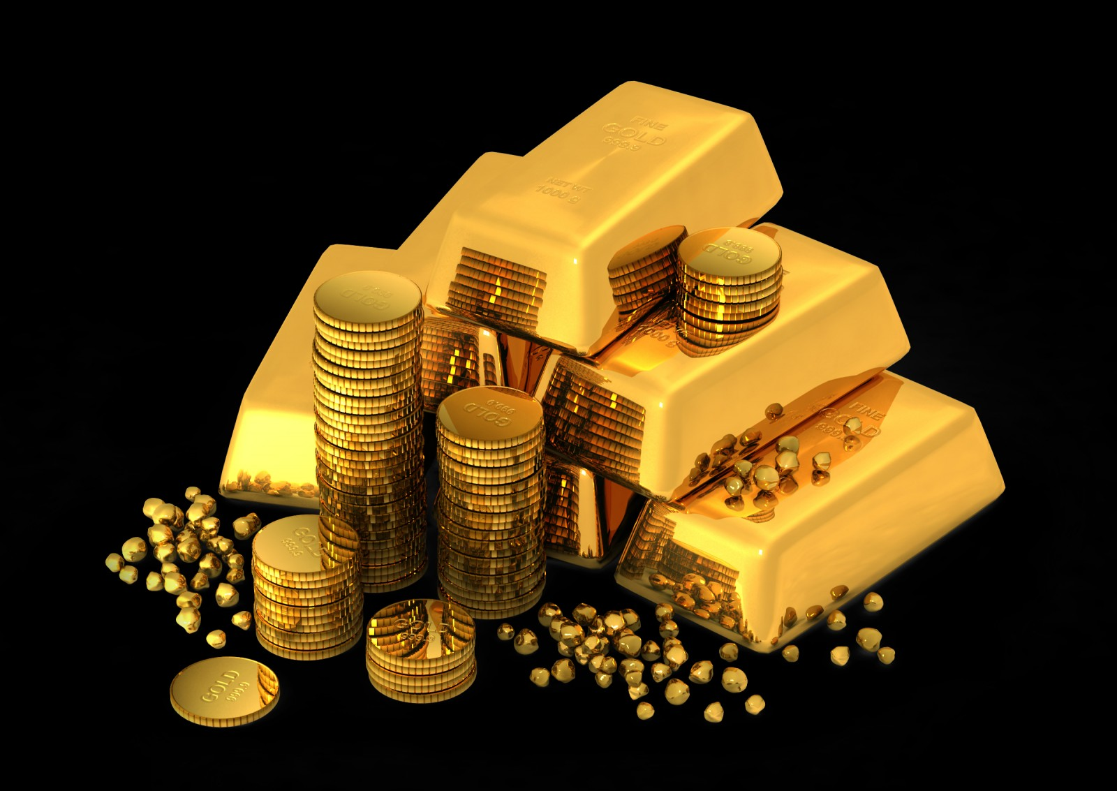
REASONS FOR FLUCTUATIONS IN gold PRICES
Depreciation of the US dollar
Interest rates, opportunity for holding gold
Terrorist attacks and 2001 recession
Debt recession in 2011
Inverse relation between gold and exchange rate (2012)

Slide 16
Reasons for fluctuations in cocoa prices
Competition from other goods(Rubber in Brazil)
Political instability in cocoa producing countries (Ivory Coast 2000)
Increase in demand for cocoa commodity after recession (2008,200%increase)
Reduced labor for cocoa production in Ivory Coast due to the awareness that children were involved in child labor(2013)

Slide 17
references
https:// www.theeconomist.com
https:// www.agiboo.com
https://www.sunshineprofits/sold.silver/dictionary/gold-greatrecession.com
https://www.investopedia.com/financial-edge/0311/what-drives-the-price-of-gold.aspx
https://goldprice.org/gold-price-chart.html
https://www.bing.com/images/search?q=Gold%20&qs=n&form=QBIR&sp=-1&pq=&sc=0-0&sk=&cvid=58EBEC32699446AE80A4D6960D87F7F9

Slide 18


